Slide 1


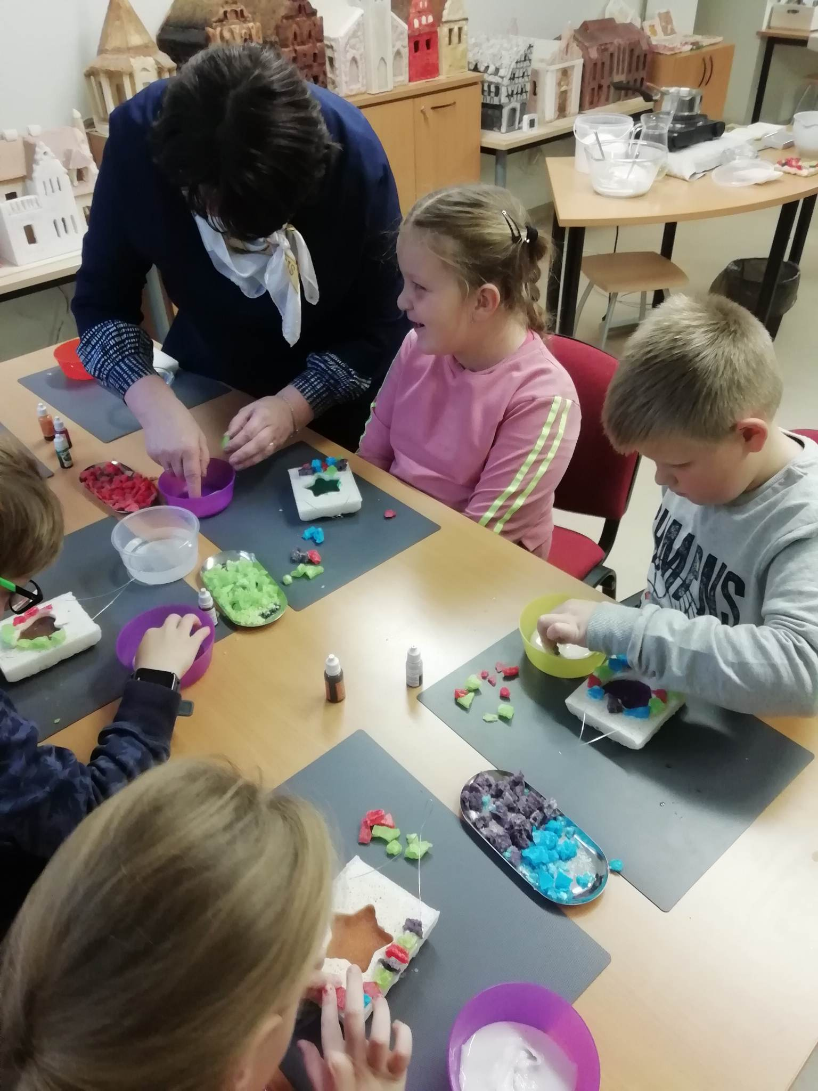



Erasmus + project no. 2021-2-CZ01-KA210-SCH-000051219 „Don't Ignore Me !“.
CHILDREN WITH SPECIAL EDUCATION NEEDS IN LITHUANIA
Kaunas International gymnasium

Slide 2
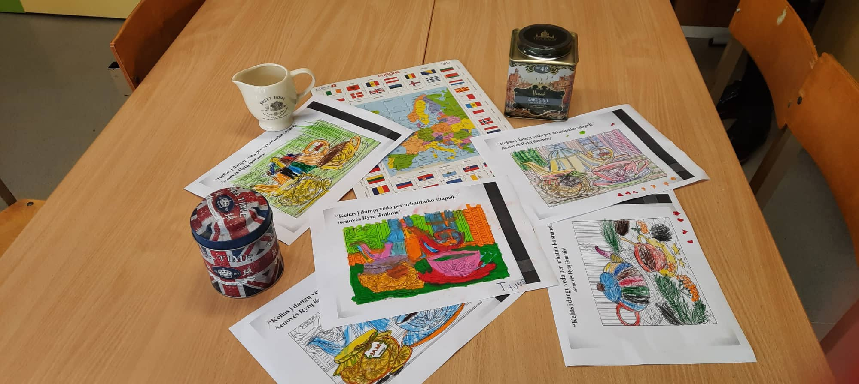
Erasmus + project no. 2021-2-CZ01-KA210-SCH-000051219 „Don't Ignore Me !“.
Special education is an education that is organized in a way that meets the special needs of a child. To achieve that goal we need: (D. Hallahan, P., J. M. KAUFFMAN, 2003):
  special teaching tools,
  teaching techniques,
  methods or special equipment.

Slide 3
Erasmus + project no. 2021-2-CZ01-KA210-SCH-000051219 „Don't Ignore Me !“.
According to the laws in Lithuania teachers have to adapt General Education programs for children with education needs. According to the recommendations of specialists and PPT (Pedagogical Psychological Service). Depending on the level of special need (3 levels) a child receives help of these specialists:
  psychologist,
  speech therapist,
  social pedagogue,
  special pedagogue,
  teacher of the deaf,
  typhoid teacher,
  assistant teacher.
Law about organizing special need education: https://www.etar.lt/portal/lt/legalAct/TAR.F0E90ABE387D)

Slide 4
Erasmus + project no. 2021-2-CZ01-KA210-SCH-000051219 „Don't Ignore Me !“.
According to information given 2019/2020 there were 41 347 students with special education needs. (88% were studying in General Education classes). Lithuania has politically chosen a multi-track education system, which offers various ways, forms of education and institutions to educate people with special educational needs (Aidukienė, Labinienė, 2003). One of them is inclusive education.

Slide 5
Erasmus + project no. 2021-2-CZ01-KA210-SCH-000051219 „Don't Ignore Me !“.
Inclusive education
"Inclusive education is the process of strengthening the ability of the education system to reach all students..." (UNESCO, 2009). To achieve this, there are some important factors:
  Care for every student.
  Participation and involvement of every student.
  Teachers' qualification.
  Encouragement and support.
  Attitude.
  Individualization (learning goals, plans, material and setting).
  Collaboration.
  Problem solving together.
Notes:
1. Inclusive education is a process during which Inclusion is strengthened, including not only students with special educational needs, but also a much wider circle of students. An inclusive education system cares about every student who is at risk of being excluded, resulting in school failure.
2.
It is not enough just to be able to study in a general education school. Participation is the involvement of all children in educational activities that are meaningful to each of them
3. It is especially important to form positive attitudes in the education system: 1) to ensure that all teachers have the necessary knowledge and skills and take responsibility for the education of all students; 2) to encourage and support the participation of students in considering their own educational issues and making decisions. And parents are helped to get the necessary information about their children's education and make appropriate decisions.
4. Factors that increase the possibilities of student participation: 1) the attitude that learning is a process. The main goal is to aim for all students to learn to learn, not to acquire specific knowledge of a specific subject; 2) to individualize the education of each student, so that the student, together with teachers and parents, can set, predict, adjust his own learning goals, so that he has the opportunity to study independently and take responsibility for his own learning; 3) prepare individual education plans for students with greater special needs, the purpose of which is to increase students' independence and the opportunity to participate in setting their educational goals
4. Teaching in collaboration with the entire school community and support professionals.

Slide 6
Erasmus + project no. 2021-2-CZ01-KA210-SCH-000051219 „Don't Ignore Me !“.
Programs and plans
  General program.
  Adapted General Program.
  Individualized education program.
Official recommendations how to adapt or individualize programs for each subject: https://www.nsa.smm.lt/wp-content/uploads/2016/01/16_BP-pritaikymo-rekomendacijos.pdf
Notes:
General program
• The scope of the educational content is not changed, the students' progress and
achievement evaluation criteria.
• The student's achievements are at a satisfactory level, corresponding to the student achievements specified in the two-year period
level signs.
• Conventional methods and methods of education are used, alternative methods of education are episodically applied and
methods.
Adapted General Program
• Adaptation of programs for subjects 1-5.
• The student's achievements are below the satisfactory level, do not correspond to the students specified in the two-year period
signs of achievement levels, but it is possible to compensate them with established signs.
• Conventional educational methods and techniques are combined with continuously applied alternatives.
Individualized education program
• Adaptation of programs in all areas of education, subject content, subject area content is adapted to activities,
to develop independence, social skills.
• The student's achievements are significantly lower than the indicated student achievement levels for the two-year period
signs
•Instead of the separate educational areas specified in the General Programs, the education of subjects is organized separately
activities.
•Alternative methods and ways of education.

Slide 7
Erasmus + project no. 2021-2-CZ01-KA210-SCH-000051219 „Don't Ignore Me !“.
Specialists' training
  REPUBLIC OF LITHUANIA LAW ON SPECIAL EDUCATION, December 15, 1998 No. VIII- 969, Vilnius, CHAPTER V, TRAINING OF SPECIAL EDUCATION SPECIALISTS, ARTICLE 30. Special Teacher Training.
1. Universities shall train special teachers in accordance with qualification requirements established by the Ministry of Education and Science.
2. Teachers lacking special teacher training who work with persons with special needs in Special Education institutions, general education institution special classes and groups, must become qualified to work as to work as special teachers in accordance with the qualification requirements established by the Ministry of Education and Science and the procedure of teacher training.
  ARTICLE 31. Training and Qualification Improvement of Teachers Psychologists, Social Workers of Institutions of General Education.
1. The universities and colleges which are engaged in teacher, psychologist and social worker training and institutions of teacher qualification improvement, responsible for teacher qualification shall include special pedagogical and special psychology courses into study and qualification improvement programmes.
2. The procedure of teacher certification shall be defined by the certification regulations. In the process of certification of teachers and psychologists and granting them the qualification of working as a teacher, their knowledge of Special Education and special psychology shall be assessed.
Notes:
According to the laws, Universities train future specialists for children with special needs. They are responsible for preparing special needs teachers, psychologists, speech therapist, social pedagogue, special pedagogue, teacher of the deaf, typhoid teacher,
assistant teacher. However, if a teacher from general educations decides to change the specialty he or she can get additional qualification and skills by finishing courses. In Kaunas we have education and innovation center which organizes such courses.
Educational assistance is defined in the Education Law of the Republic of Lithuania as "assistance provided by specialists to students, their parents (guardians, care takers), teachers and education providers, the purpose of which is to increase the effectiveness of education".
Along with various school employees (educators, teachers, teaching assistants, health care specialists, school managers), the most important role in providing educational support at school belongs to various student support specialists.

Slide 8
Erasmus + project no. 2021-2-CZ01-KA210-SCH-000051219 „Don't Ignore Me !“.
  Although, according to experts, the model of the Lithuanian education support system functions well and has good potential, the issue of training support specialists does not lose its relevance.
  As the number of students with SEN or who have been diagnosed with SEN is growing in the country, there is a lack of specialist support for pupils in schools. in 2021 there was a shortage of educational support specialists in 29 municipalities.
  According to the data of the educational management information system, according to the norms, there was a shortage of 1,622 student support specialists, including 400 psychologists, 452 special pedagogues, 600 teacher assistants, etc. specialists providing assistance. Even the students who receive educational support, as research shows (Šapelytė et al., 2021), do not receive enough of it, so it is appropriate to pay attention to the emphasis of training such specialists.
  According to the data of the Open Information, Consulting and Orientation System (AIKOS), social pedagogues are trained by five universities (Vilnius University (hereinafter - VU), Klaipėda University (hereinafter - KU), Vytautas the Great University (hereinafter - VDU), Kaunas University of Technology (hereinafter - KTU ), Mykolas Romeris University (hereinafter - MRU)) and two colleges (Utena and Kaunas). Most of them are the first stages - bachelor's, professional bachelor's studies, while master's level studies are conducted only by Klaipėda University.

Slide 9
Erasmus + project no. 2021-2-CZ01-KA210-SCH-000051219 „Don't Ignore Me !“.
  Special pedagogues are trained by two higher education institutions (VU and VDU), which grant both a bachelor's degree in educational sciences (together with a teacher's qualification) and a master's degree.
  Those studying special pedagogy or speech therapy at VMU already have the opportunity to choose in-depth specializations (Education of children with hearing impairments (Surdopedagogika); Education of children with visual impairments (Tiflopedagogy); Education of children with autism spectrum and/or behavioral disorders) already at the first stage of studies.

Slide 10
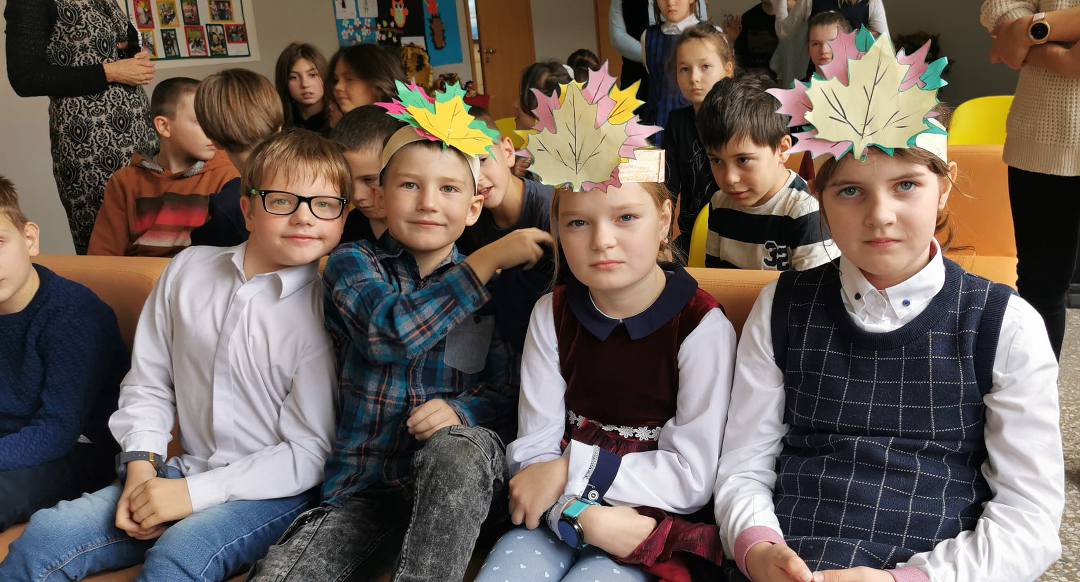
Erasmus + project no. 2021-2-CZ01-KA210-SCH-000051219 „Don't Ignore Me !“.
Situation Today....
Currently, special classes and schools mostly educate students with high and very high educational needs.
The general education school is not yet sufficiently capable of integrating the disabled, especially children with impaired intelligence.
Conflicting attitudes of teachers, students and their parents regarding integration are evident.
Meanwhile, the special school is also going through a crisis.
Notes:
Currently, special classes and schools mostly educate students with high and very high educational needs, which is why they have difficulty integrating into general education institutions and this process is slow (Urbanovič et al., 2020). The general education school is not yet sufficiently capable of integrating the disabled, especially children with impaired intelligence, conflicting attitudes of teachers, students and their parents regarding integration are evident. Meanwhile, the special school is also going through a crisis: it does not sufficiently prepare its pupils for independent life, they do not fully develop social skills. For special students, who are educated together with regular students, education must be of high quality, which is a complex and long-lasting process that requires state management, education administration and the awareness of the whole society.

Slide 11
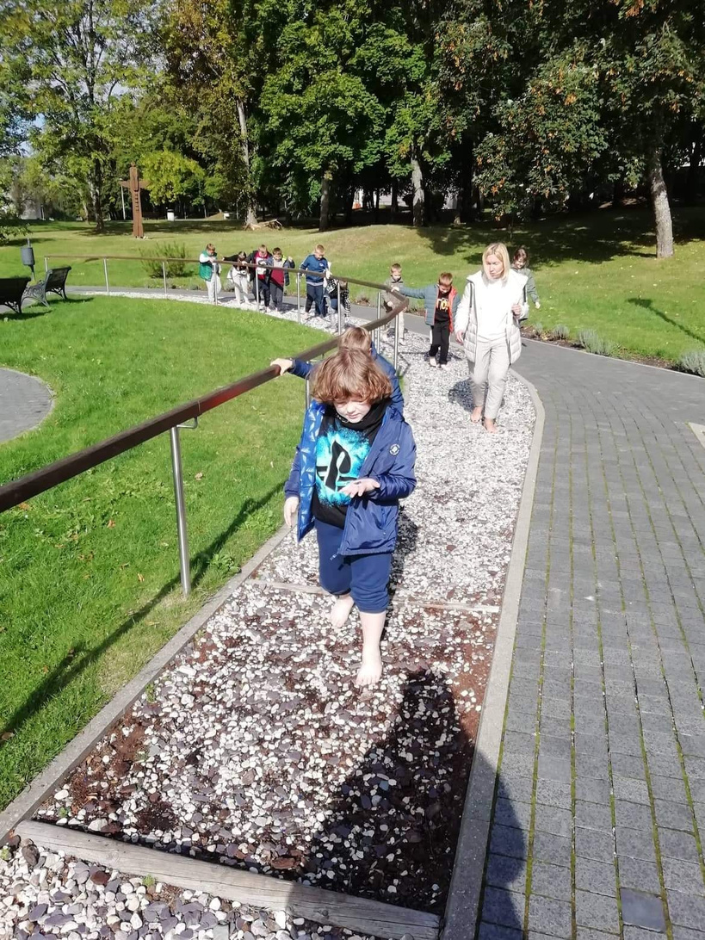
Erasmus + project no. 2021-2-CZ01-KA210-SCH-000051219 „Don't Ignore Me !“.
Inclusive education – the reality of Lithuania schools in 2024 or just a goal that is unlikely to be achieved?
  If you want to make this type of education successful and create inclusive environment, you have to link general and special education systems.
  The example of Lithuania shows that it is not easy to create such a system and it takes a lot of effort, competence, cooperation and political will to fully implement the simple idea of ​​quality and accessible education for all.
  In Lithuania parents raising a disabled child still face the situation that their children, who need educational assistance or physical adaptation of classroom facilities, are not admitted to general education schools and are offered to study in special schools and aren‘t fully able to integrate into society and learn with children who don‘t have special needs.
Notes:
Inclusive education is not only an approach, teaching, but also a different organization of education. If you want to make this type of education successful and create inclusive environment, you have to link general and special education systems, take an interactive approach to disability, develop and effectively implement curricula, realistically differentiate education, evaluate and record children ‘s individual cognition and the effectiveness of positive assistance, create a system of support for students, improve the competence of teachers and specialists, improve inter – institutional cooperation and the usage of resources purposefully.
The example of Lithuania shows that it is not easy to create such a system and it takes a lot of effort, competence, cooperation and political will to fully implement the simple idea of ​​quality and accessible education for all.
The Seimas of the Republic of Lithuania ratified the United Nations Convention on the Rights of Persons with Disabilities in 2010 and committed to ensure equal opportunities for children with various types of special needs to study in any educational institution with other students, but in reality the system doesn‘t work and further efforts are still needed to minimize barriers to learning for students with special needs.
In Lithuania parents raising a disabled child still face the situation that their children, who need educational assistance or physical adaptation of classroom facilities, are not admitted to general education schools and are offered to study in special schools and aren‘t fully able to integrate into society and learn with children who don‘t have special needs. In 2021 there are still 44 special schools in Lithuania, where more than 3,000 students with high and very high special educational needs study, and another 1,500 such children attend special pre-school education institutions. There are also about 40,000 students in general education schools who have a variety of other special

Slide 12
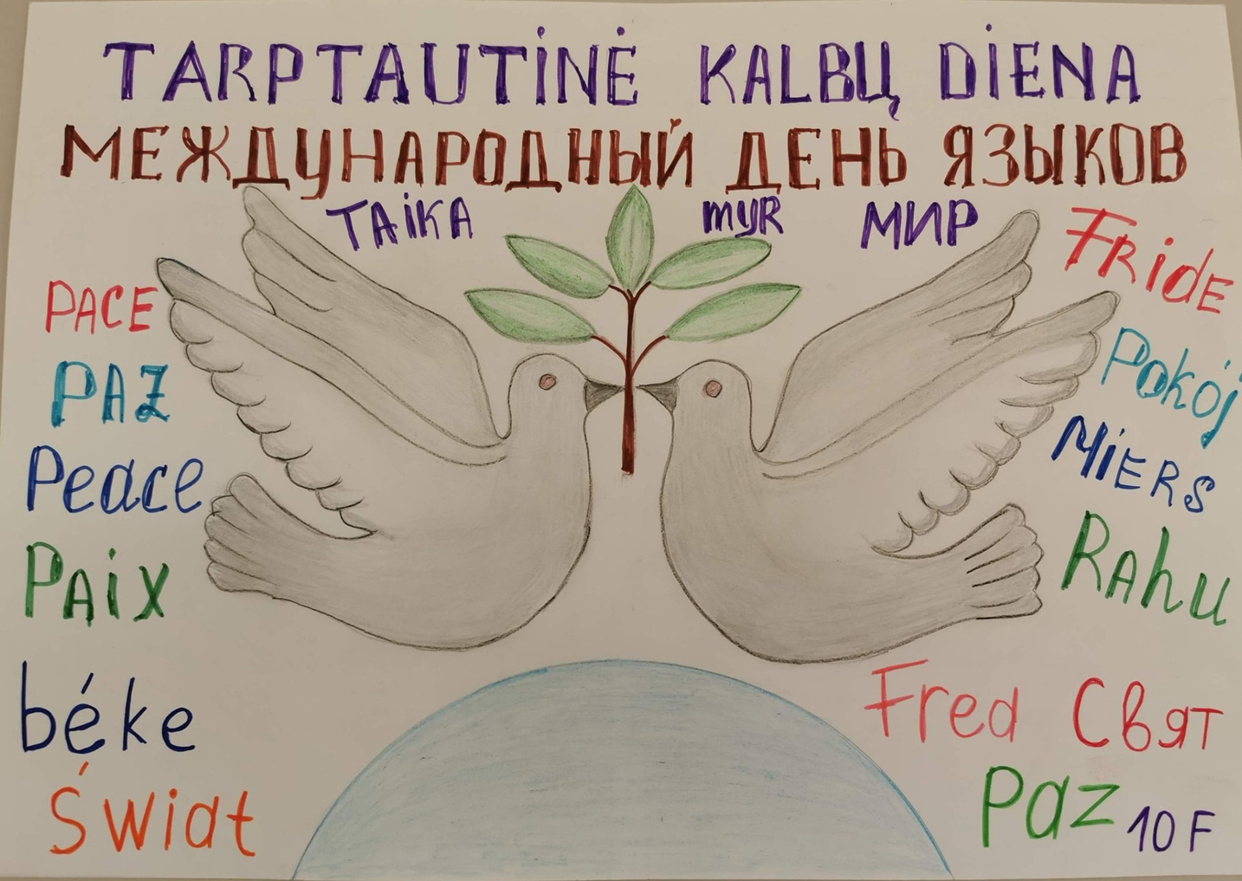
Erasmus + project no. 2021-2-CZ01-KA210-SCH-000051219 „Don't Ignore Me !“.
  In June 2020, Seimas adopted amendments to the Law on Education, which create legal preconditions gradually increase the inclusion of children with special educational needs in education system until the 1st of September 2024.
  To achieve this goal in 2024, about 173 million euros should be allocated from the state budget. It is also necessary to expand support system in schools, admit more educational support professionals and teaching assistants to schools and allocate money to their salaries, adapt the school environment for inclusive education, improve the qualification of all teachers and their competences so that they can work in the classroom with children with special educational needs.
  The first step towards inclusive education in Lithuania was taken with the adoption of amendments to the Law on Education, but the education community is already anxiously waiting 2024, as it doubts whether it will be possible to prepare for it in practice in such a short time.
Notes:
Politicians have felt public pressure for the implementation of the concept of inclusive education in practise for a very long time and finally, in June 2020, Seimas adopted amendments to the Law on Education, which create legal preconditions gradually increase the inclusion of children with special educational needs in education system until the 1st of September 2024.
Although the amendment to the law has been passed, the municipalities and the schools themselves and their communities have a lot of work to do and prepare for it. To achieve this goal in 2024, about 173 million euros should be allocated from the state budget. It is also necessary to expand support system in schools, admit more educational support professionals and teaching assistants to schools and allocate money to their salaries, adapt the school environment for inclusive education, improve the qualification of all teachers and their competences so that they can work in the classroom with children with special educational needs.
The first step towards inclusive education in Lithuania was taken with the adoption of amendments to the Law on Education, but the education community is already anxiously waiting 2024, as it doubts whether it will be possible to prepare for it in practice in such a short time.

Slide 13
Erasmus + project no. 2021-2-CZ01-KA210-SCH-000051219 „Don't Ignore Me !“.
Literature
  Ališauskas A., Ališauskienė S, Gerulaitis D., Melienė R., Miltenienė L. (2010). Specialiųjų poreikių asmenų ugdymo(si) formų įvairovės tyrimas.
  Ališauskas A., Šimkienė G. (2013). Mokytojų patirtys, ugdant mokinius, turinčius elgesio ir (ar) emocijų problemų. Specialusis ugdymas, (1), 51-61.
  Aidukienė T. (2014). [Žiūrėta 2022-11-12]. Prieiga per: file:///C:/Users/Mokinys/Desktop/EES%20Knygos/Inkliuzija%20(AIDUKIENĖ).pdf
  Ališauskienė S., Miltenienė L. (2018). Inkliuzinis ar įtraukusis ugdymas: socialinių konstruktų interpretacijos švietimo kaitos kontekste. Specialusis ugdymas, 2018 - etalpykla.lituanistikadb.lt
  Ališauskienė S., Miltenienė L., Inkliuzinis ar įtraukusis ugdymas: socialinių konstruktų interpretacijos švietimo kaitos kontekste. Šiauliai, 2018.
  Ališauskienė S., Kaffemanienė I., Ališauskas A. (2016). Būsimųjų specialiųjų pedagogų kompetencijų įsivertinimas personalizuoto mokymosi paradigmos požiūriu. Specialusis ugdymas, (1), 189-208.
  Europos specialiojo ugdymo plėtros agentūra, 2009. Raktiniai inkliuzinio švietimo kokybės plėtros principai – Rekomendacijos politikams, Odense, Danija: Europos specialiojo ugdymo plėtros agentūra https://www.european-agency.org/sites/default/files/key-principles-forpromoting-quality-in-inclusive-education_key-principles-LT.pdf (žiūrėta 2022-11-12).
l.

Slide 14
Erasmus + project no. 2021-2-CZ01-KA210-SCH-000051219 „Don't Ignore Me !“.
  Giedrienė R. (2014). Požiūris į kitokį vaiką: pradinės mokyklos atvejis. Socialinis ugdymas, 38(2).
  Hallahan D., KAUFFMAN P., J. M. Ypatingieji mokiniai. Specialiojo ugdymo įvadas. Alma Litera. Vilnius. 2003.
  Mažylienė A., Gutauskienė R., Tumelienė R., Špokienė R. (2011). Inkliuzinis ugdymas ir komandinė pagalba mokiniui. Metodinės rekomendacijos mokytojams, švietimo pagalbos teikėjams.
  Miltenienė L., Daniutė S. (2014). Pedagogų ir būsimųjų pedagogų kompetencija ugdyti įvairių poreikių turinčius mokinius inkliuzinio švietimo kontekste. Specialusis ugdymas,(1), 9-26.
  Miltenienė L., Melienė R. (2010). Specialiojo ugdymo formos inkliuzinio ugdymo kontekste: Olandijos patirtis. Specialusis ugdymas, (1), 133-140.
  Samsonienė L. Specialiųjų poreikių vaikai ir jų socialinė integracija. Mokomoji knyga. Vilnius: Vilniaus universiteto leidykla, 2006.
  Urbanovič J. ir kt., Lietuva. Švietimas šalyje ir regionuose 2020. Finansavimas. NŠA. Vilnius, 2020.

